Slide 1
Title of the training unit/lesson
Sub-title
Author • WP XX

Slide 2
KEY WORDS.
HELP NOTE
Keywords.
Words used to classify or organize digital content, or to facilitate an online search for information.

Slide 3
contents
Learning outcomes.
Introduction.
Title 1 level 1.
Title 1.1 level 2.
Title 1.2 level 2.
Title 2 level 1.
Title 2.1 level 2.
……
Title n level 1.
Title n.1 level 2.
Title n.2 level 2.
Summary and conclusions.
Bibliography and/or References.

Slide 4
Learning outcomes.
HELP NOTE
Learning outcomes.
After determining the aims of the training, the learning outcomes can be defined. Learning outcomes are described by the European Qualifications Framework (EQF) as statements of what a learner knows, understands and is able to do on completion of a learning process. They are the knowledge, skills and attitudes (= competences) that the learners are expected to have attained and mastered upon successful completion of the training course. Typically, learning outcomes have measurable outcomes and can be assessed through some type of testing procedure. Therefore, a list of learning outcomes appears as a series of statements that can be described in a full sentence as follows :
“Upon successful completion of this training course, participants should be able to…”
This sentence is than usually followed by an action verb which is specific to the type of learning outcome in terms of knowledge and skills. Examples of these action verbs can be found in Bloom’s taxonomy, which is one of the best aids to writing good learning outcomes (see Appendix A- D13.5. Quality criteria and training specifications)
After the completion of this training unit/lesson, the students/participants should be able to….

Slide 5
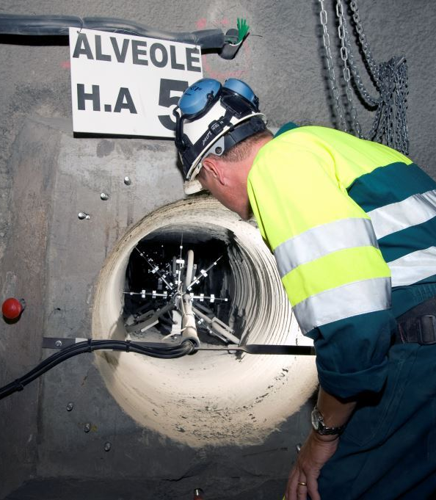
INTRODUCTION
HELP NOTE
Introduction
One or more introductory screens describing how the knowledge gained from the course will be used and the benefits of having that knowledge.
The purpose of the introduction is to motivate learners to proceed with
the lesson.
Level 1 - Inter has ruinarum varietates a Nisibi quam tuebatur accitus Vrsicinus, cui nos obsecuturos iunxerat imperiale praeceptum, dispicere litis exitialis certamina cogebatur abnuens et reclamans.
Level 2 - adulatorum oblatrantibus turmis, bellicosus sane milesque semper et militum ductor sed forensibus iurgiis longe discretus, qui metu sui discriminis anxius cum accusatores quaesitoresque subditivos.
Level 3 - Sibi consociatos ex isdem foveis cerneret emergentes, quae clam palamve agitabantur, occultis Constantium litteris edocebat inplorans subsidia, quorum metu tumor notissimus Caesaris.
Level 4 - Inter has ruinarum varietates a Nisibi quam tuebatur accitus Vrsicinus, cui nos obsecuturos iunxerat imperiale praeceptum

Slide 6
Title of the slide
HELP NOTE
Tips for content development
Write directly, simply and clearly.
Correct spelling and grammar.
Provide ideas or information little by little.
Avoid jargon or colloquialisms.
Informal language is acceptable but try to use neutral language.
Minimize the use of compound sentences. Check if you can simplify and clarify by breaking the sentences into shorter sentences.
Use personal pronouns to refer to students. This personalizes the instruction and engages the reader.
Use bulleted lists where appropriate.
Include images or graphs as appropriate.
Use gender-inclusive and non-sexist language.
Use the active voice. Use the passive voice only when the active voice sounds excessively forced.
Explain acronyms when they first appear and consider putting them in the glossary if appropriate.
Level 1 - Inter has ruinarum varietates a Nisibi quam tuebatur accitus Vrsicinus
Level 2 - adulatorum oblatrantibus turmis, bellicosus sane milesque semper et militum ductor sed forensibus iurgiis longe discretus
Level 3 - Sibi consociatos ex isdem foveis cerneret emergentes, quae clam palamve agitabantur
Level 4 - Inter has ruinarum varietates a Nisibi quam tuebatur accitus Vrsicinus

Slide 7
Title of the slide
HELP NOTE
Tips for content development
Write directly, simply and clearly.
Correct spelling and grammar.
Provide ideas or information little by little.
Avoid jargon or colloquialisms.
Informal language is acceptable but try to use neutral language.
Minimize the use of compound sentences. Check if you can simplify and clarify by breaking the sentences into shorter sentences.
Use personal pronouns to refer to students. This personalizes the instruction and engages the reader.
Use bulleted lists where appropriate.
Include images or graphs as appropriate.
Use gender-inclusive and non-sexist language.
Use the active voice. Use the passive voice only when the active voice sounds excessively forced.
Explain acronyms when they first appear and consider putting them in the glossary if appropriate.
Level 1 - Inter has ruinarum varietates a Nisibi quam tuebatur accitus Vrsicinus
Level 2 - adulatorum oblatrantibus turmis, bellicosus sane milesque semper et militum ductor sed forensibus iurgiis longe discretus
Level 3 - Sibi consociatos ex isdem foveis cerneret emergentes, quae clam palamve agitabantur
Level 4 - Inter has ruinarum varietates a Nisibi quam tuebatur accitus Vrsicinus
Level 1 - Inter has ruinarum varietates a Nisibi quam tuebatur accitus Vrsicinus
Level 2 - adulatorum oblatrantibus turmis, bellicosus sane milesque semper et militum ductor sed forensibus iurgiis longe discretus
Level 3 - Sibi consociatos ex isdem foveis cerneret emergentes, quae clam palamve agitabantur
Level 4 - Inter has ruinarum varietates a Nisibi quam tuebatur accitus Vrsicinus

Slide 8
SUMMARY AND CONCLUSIONS.
HELP NOTE.
Summary and/or conclusions.
List of key points in the lesson.
The purpose of the summary/ conclusions is to help the learner understand the lesson’s key points.
Organize the ideas in the summary starting with the most relevant to the least important.
Do not literally copy the same information that you are summarizing.
Make sure that the writing is no longer than the original text.
Plan, write, review and edit the text to have a quality product.
Level 1 - Inter has ruinarum varietates a Nisibi quam tuebatur accitus Vrsicinus, cui nos obsecuturos iunxerat imperiale praeceptum, dispicere litis exitialis certamina cogebatur abnuens et reclamans.
Level 2 - adulatorum oblatrantibus turmis, bellicosus sane milesque semper et militum ductor sed forensibus iurgiis longe discretus, qui metu sui discriminis anxius cum accusatores quaesitoresque subditivos.
Level 3 - Sibi consociatos ex isdem foveis cerneret emergentes, quae clam palamve agitabantur, occultis Constantium litteris edocebat inplorans subsidia, quorum metu tumor notissimus Caesaris.
Level 4 - Inter has ruinarum varietates a Nisibi quam tuebatur accitus Vrsicinus, cui nos obsecuturos iunxerat imperiale praeceptum

Slide 9
Bibliography and/or References.

