Slide 1
PROJECT INTRODUCTION

Slide 2
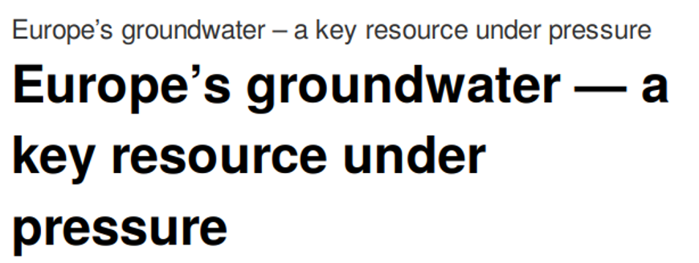
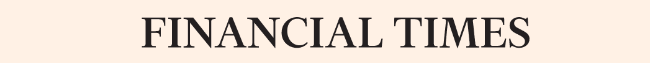
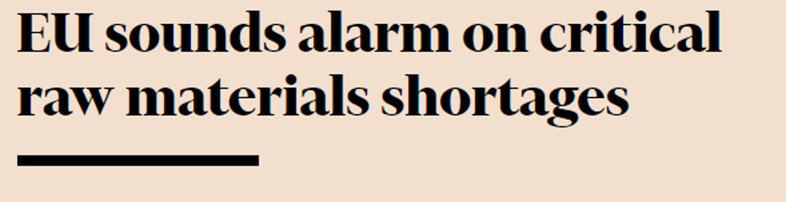

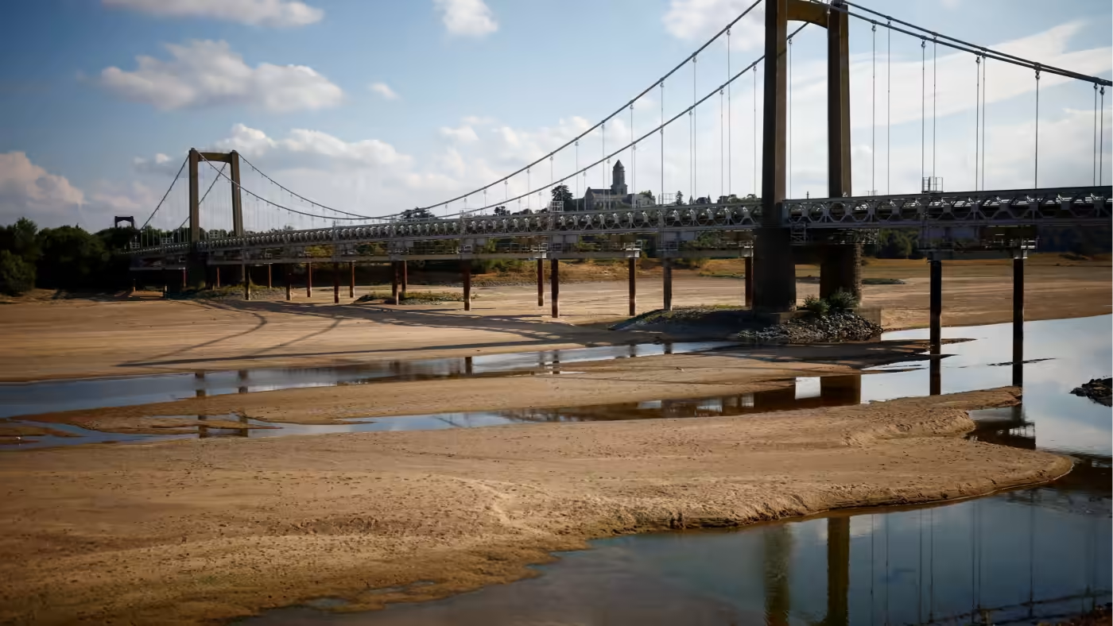
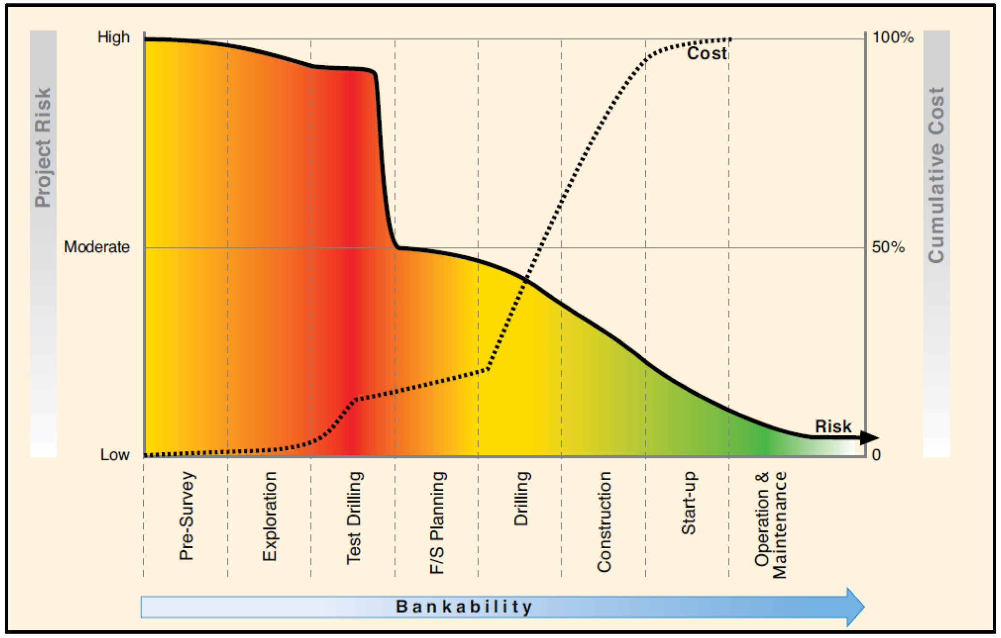


Why a Geological Service for Europe?

Slide 3
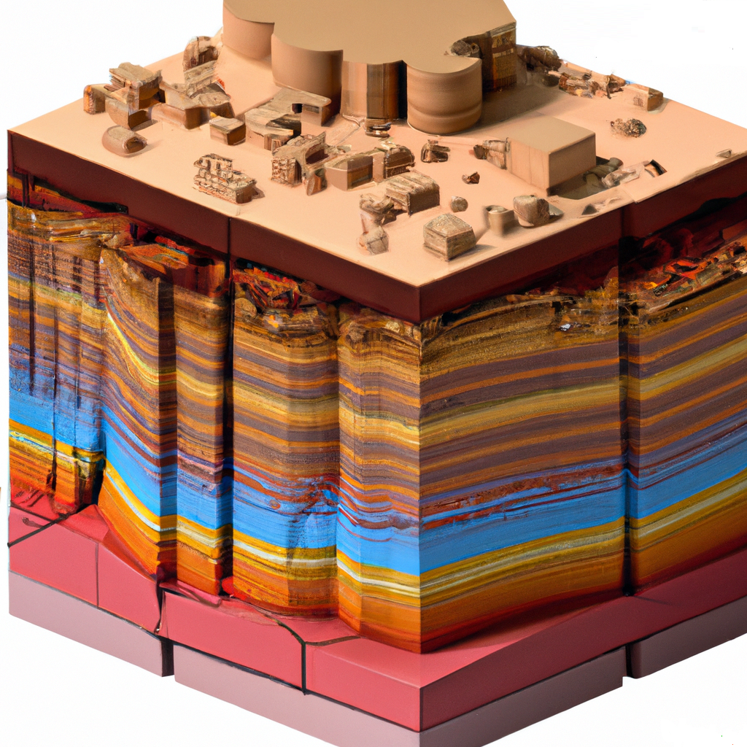

There is a Critical Need for
High-Quality Subsurface Data!

Slide 4

Objective
The overall objective of the GSEU project is to establish a Geological Service for Europe as a permanent collaborative network of European geological survey organisations.
GSEU will structurally address specific challenges in the sustainable management of the subsurface at EU and national level.

Slide 5
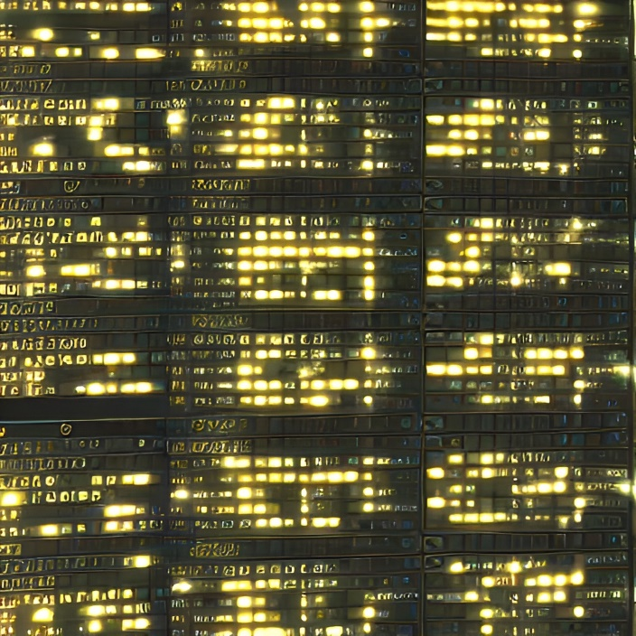
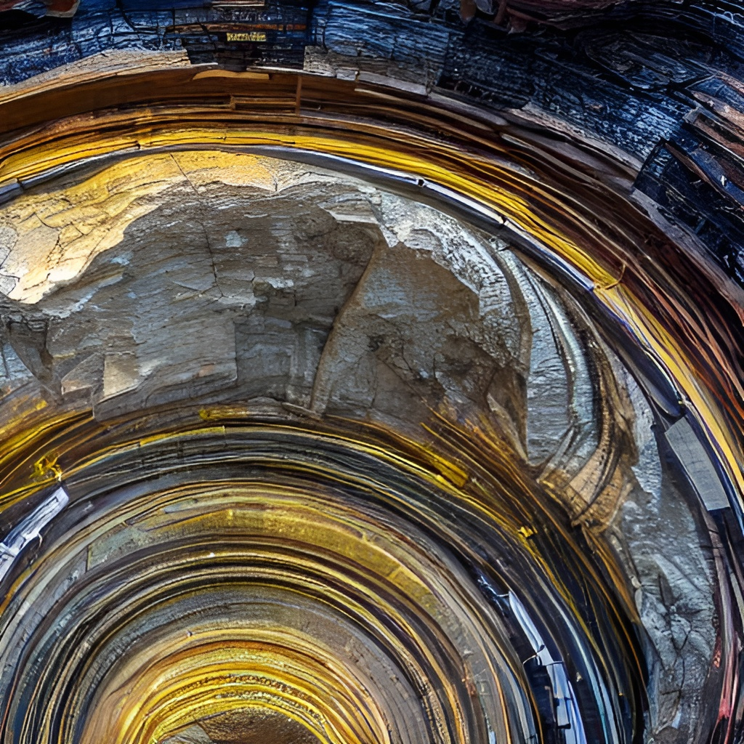




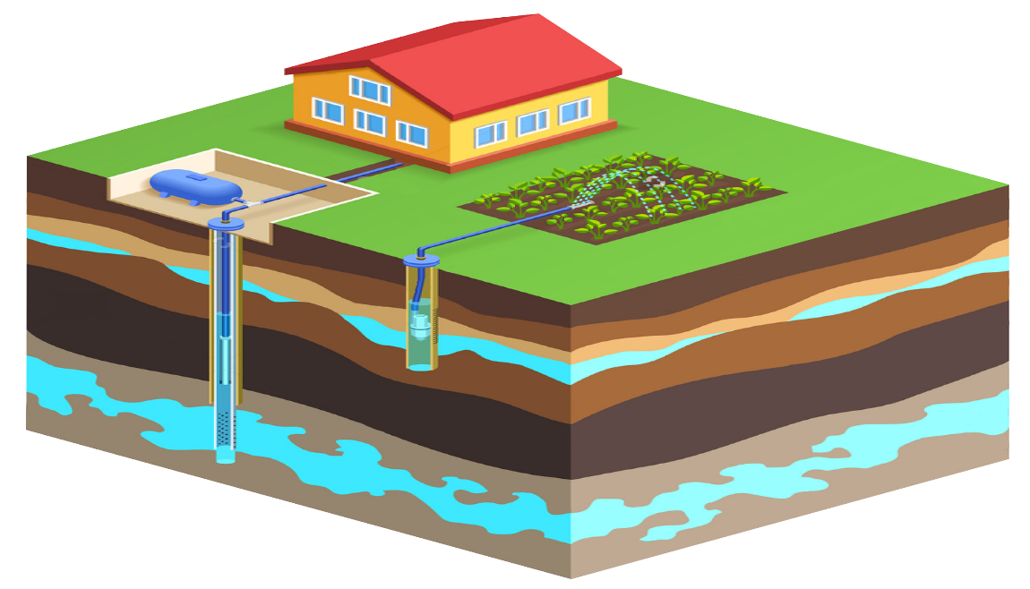

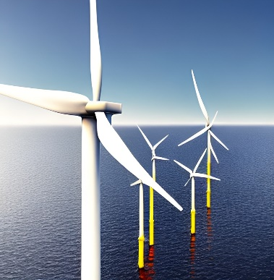
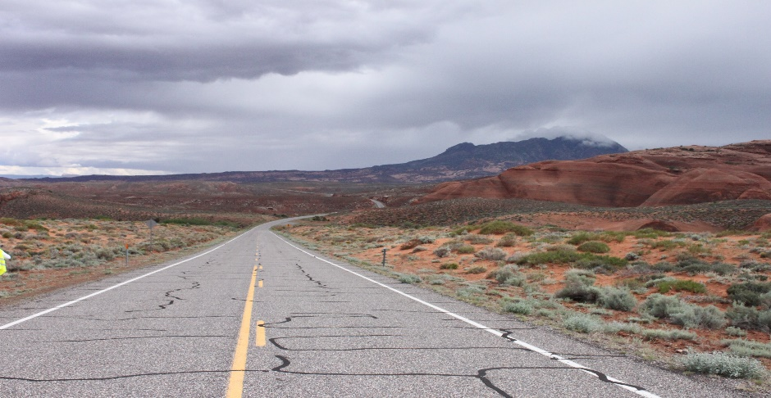


From Geological Data to Policy Support
INTEROPERABLE GEOLOGICAL DATA
3D GEOLOGICAL FRAMEWORK
Energy
Minerals
Adding value to Research & Innovation:
from Science to Society
Ground water
Climate
Radioactive Waste
Build environment
IMPACTS & PROTECTION
DECISION SUPPORT INFORMATION

Slide 6

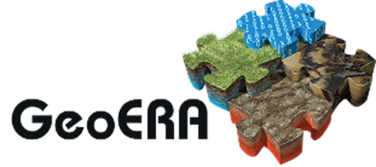




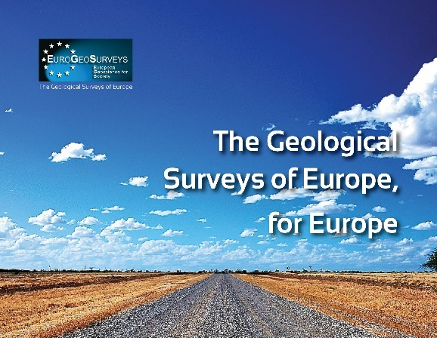


Past … Present … Future …
2010
2014
2015
2021
2022
2027

Slide 7
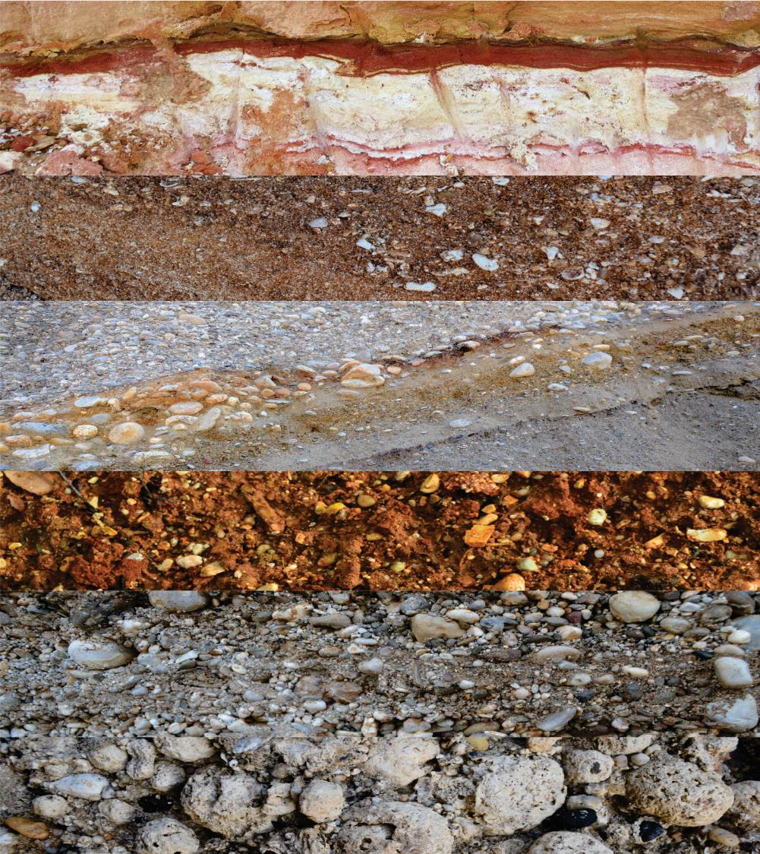
Consortium

Slide 8
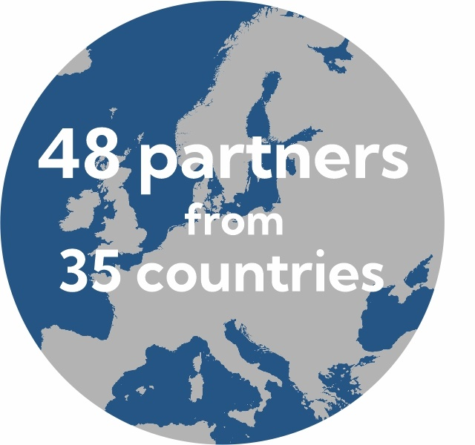
Consortium Members
National and Regional Geological Surveys are collaborating to build a
permanent network of organisations focusing on the planet itself:
the earth beneath our feet.
Find all partners at: https://www.geologicalservice.eu/about-us/project-partners

Slide 9
Consortium Members
National and Regional Geological Surveys are collaborating to build a permanent network of organisations focusing on the planet itself: the earth beneath our feet.
Geological surveys perform systematic investigation of the Earth's subsurface to gather data on its composition, structure and evolution
Our knowledge and expertise are crucial in addressing challenges in the areas of:
  Environmental and health protection
  Drinking water supply
  Protection against natural disasters
  Land management
  Exploration and sustainable management of mineral resources
  Energy transition
Our aim is to provide knowledge to society and industry, including mining, energy supply, civil engineering and environmental science, to put research into practice, to make science accessible and to inform the general public.

Slide 10
Pan-European Challenges
Cross-border Solutions
In order to address transnational and continental-scale subsurface problems we need to be able to zoom out and go beyond national borders.

Slide 11

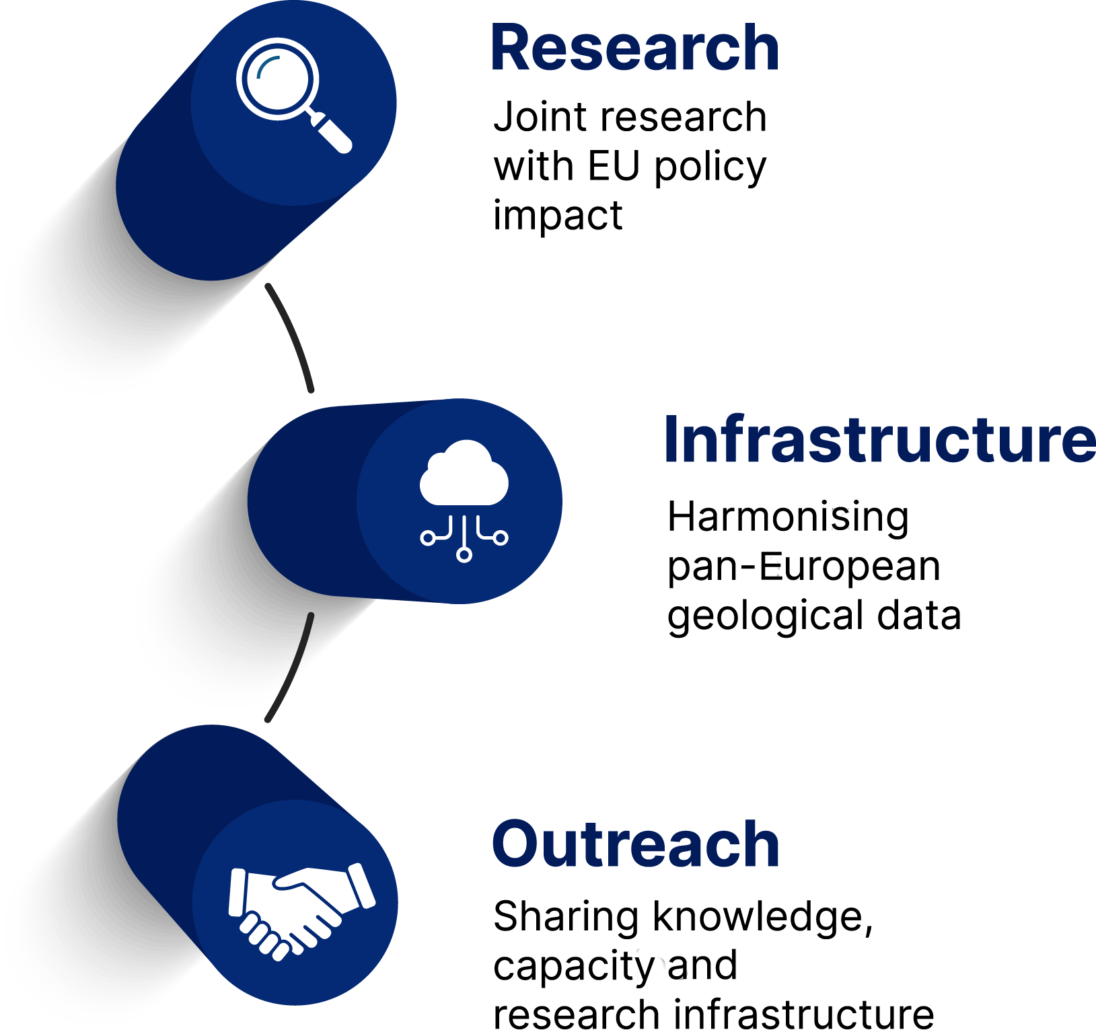
Project Coordinator
EuroGeoSurveys is a not-for-profit organisation representing the Geological Surveys of Europe.
Through the collaborative research and activities of Expert Groups and Task Forces, and the provision of open-access, harmonised geological data infrastructure, EGS provides the European Institutions, regulators, industry, and the public, geoscientific data-based advice to address key societal challenges.

Slide 12
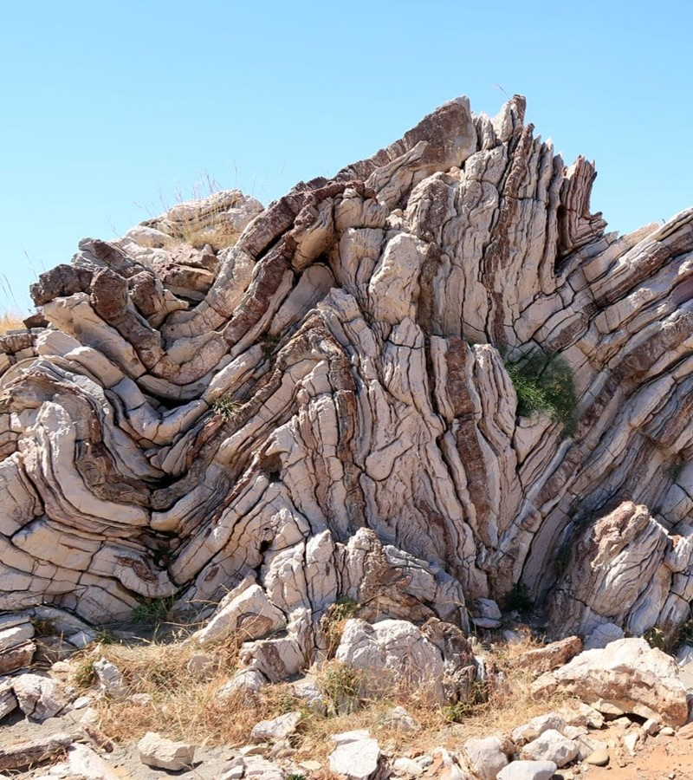
Project Structure

Slide 13
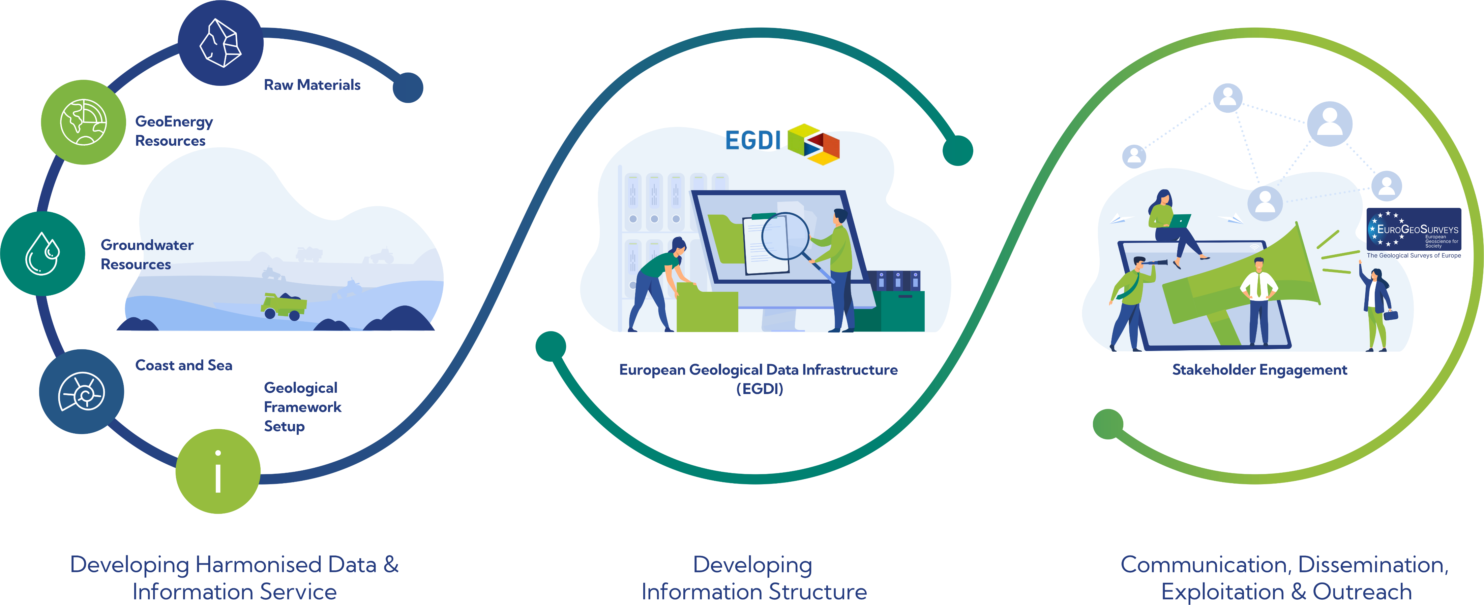
Project Structure

Slide 14
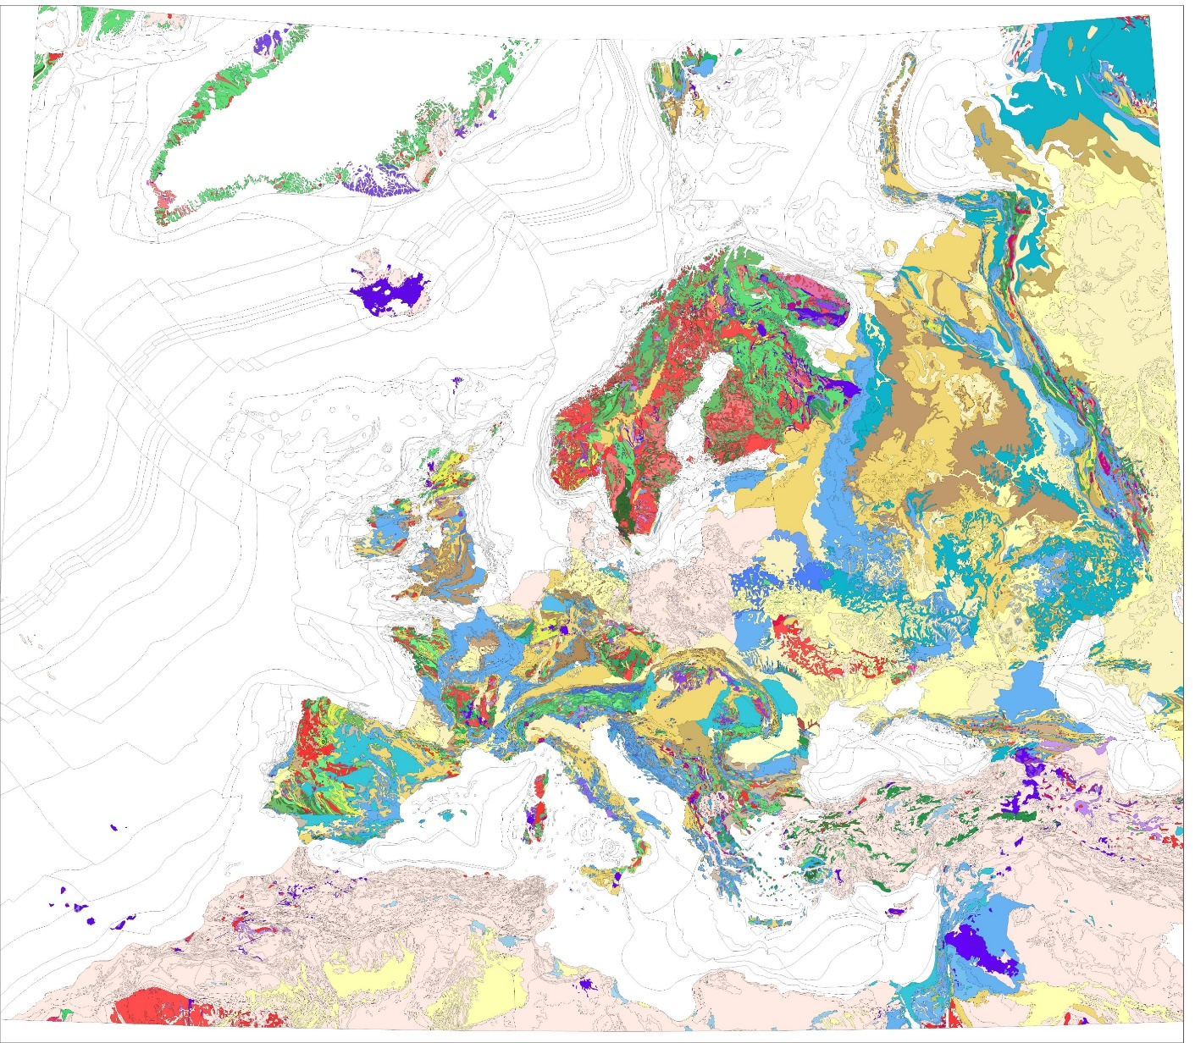
Project Result
First resulting visualisation: IGME 5000 according to GSEU lithology with application of INSPIRE portrayal rules

Slide 15
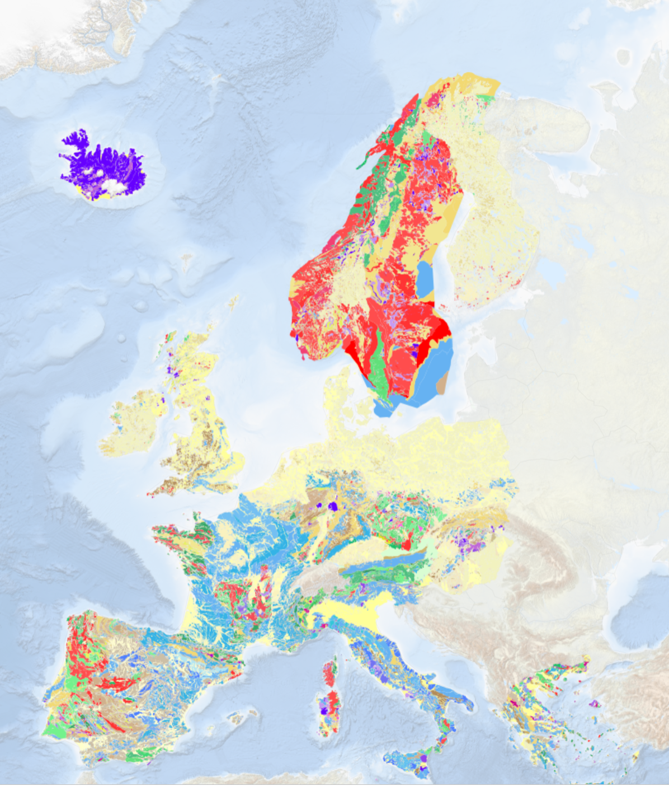
European Geological Data
Infrastructure

Slide 16
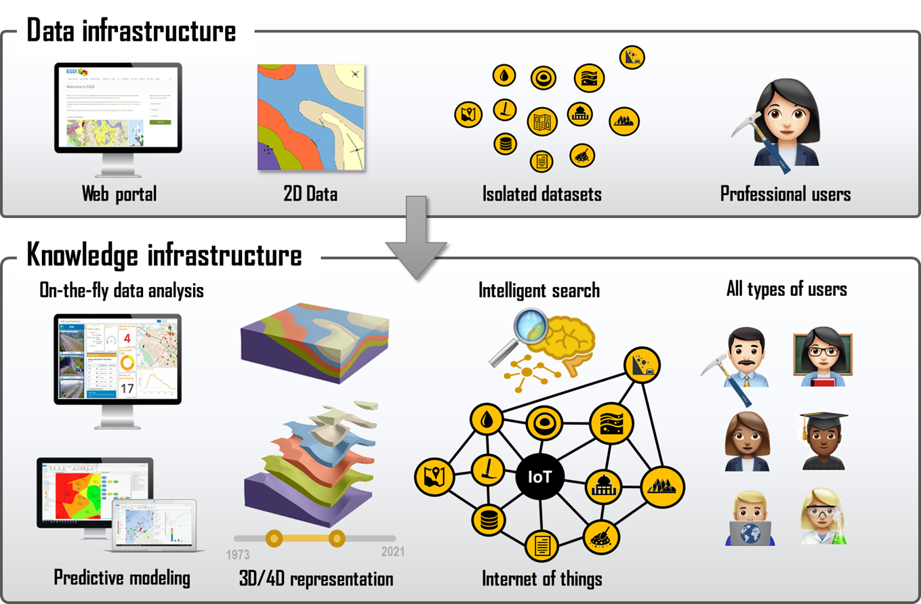
European Geological Data Infrastructure (EGDI)
The EGDI platform will be taken to a new level by transforming the current data infrastructure into a knowledge infrastructure, supporting the delivery of knowledge to policy makers and other stakeholders.

Slide 17

Maximise Social Impact

Slide 18
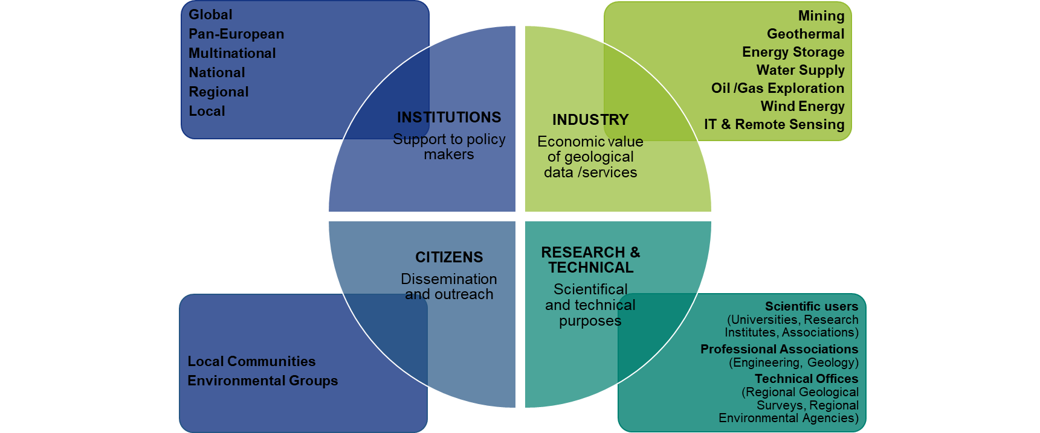
Stakeholder Engagement
We aim to inform and support a broad range of stakeholders through a programme of communication, dissemination and exploitation – to raise awareness of the critical value of the earth beneath our feet and its role in a sustainable future.

Slide 19
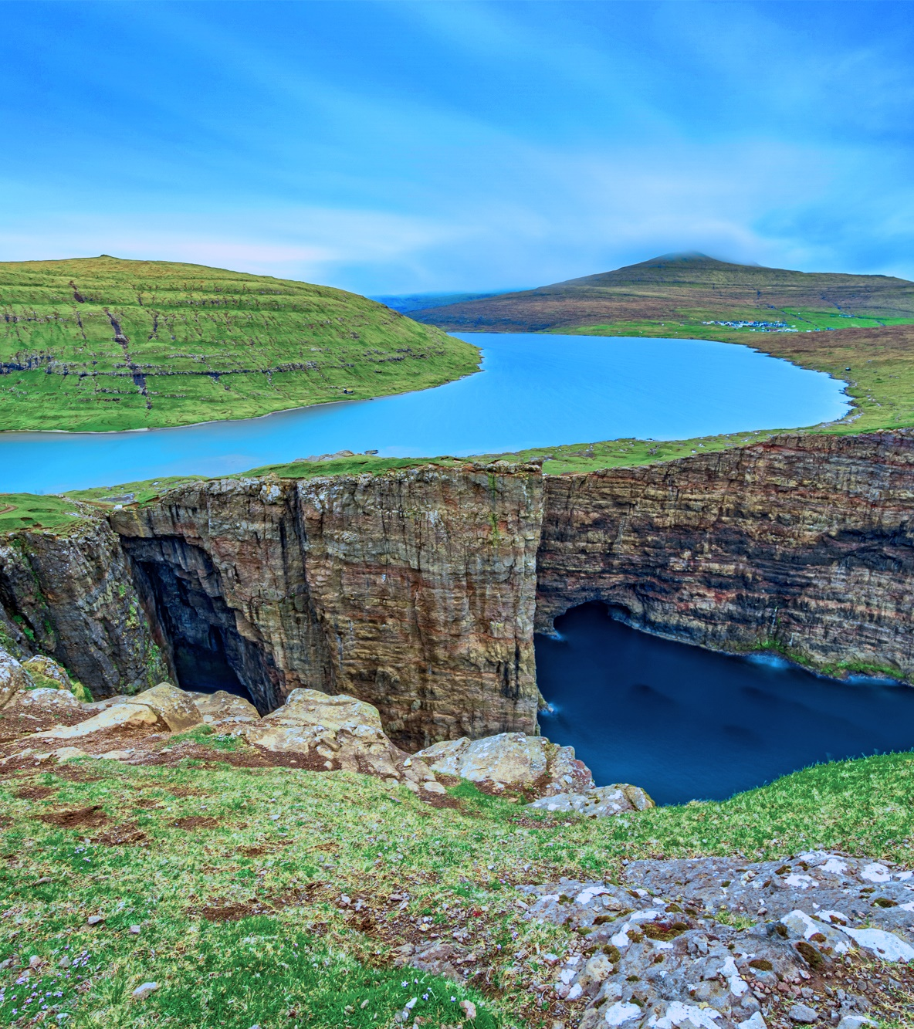
Invite you to inspect EGDI (and GSEU) web interfaces and provide feedback. You can contribute to the data and knowledge infrastructure requited for managing Radioactive Waste Management Infrastructure.

Slide 20




