Slide 1



Webinar on European Infrastructure Needs
for Radioactive Waste Management
EURAD-2 WP2 KM Task 3.2 9 March 2026 (10:00 AM – 12:00 PM CET)
Co-funded by the European Union under Grant Agreement n° 101166718

Slide 2

Welcome!
On behalf of EURAD-2 Knowledge Management (KM) and the task team: Thank you all for joining us today
We have a full agenda and are looking forward to your inputs as part of an ongoing programme of work on radioactive waste management (RWM) infrastructures within EURAD-2
Today’s Agenda:
1. Introduction (10:00-10:15)
2. Presentations on Infrastructure Initiatives (10:15-11:15)
3. Interactive Session with Live Polling (11:15-12:00)
2

Slide 3
Logistics / Teams Etiquette
✅ Do’s | ❌ Don’ts
Please keep your microphone muted when not speaking If you wish to speak, please use the “Raise Hand” feature and wait to be invited You can also use the chat function to submit your questions Please have cameras off unless presenting or asking questions Keep your questions concise and relevant to the speaker’s presentation | Please do not interrupt the speaker Please do not unmute yourself without being invited Avoid posting unrelated comments or questions in the chat
Presentation slides will be shared after the webinar
Discussions will be recorded to aid forward planning – the recording will only be available to KM partners
2

Slide 4
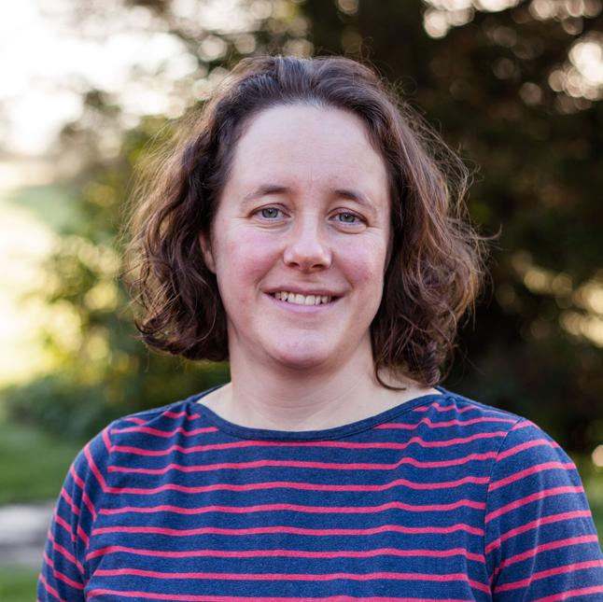
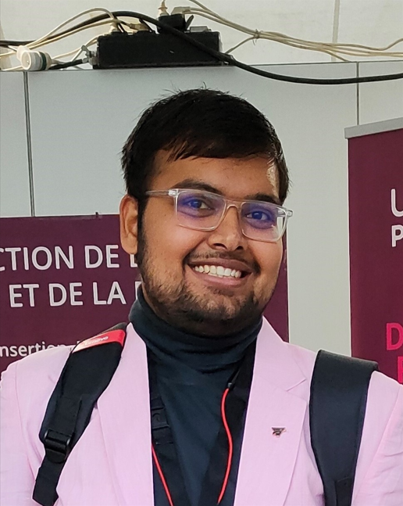
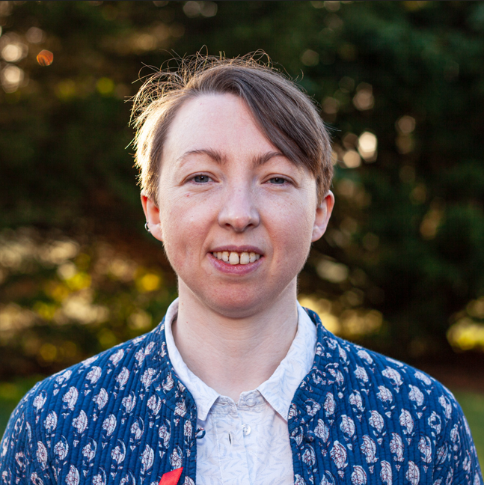
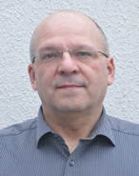


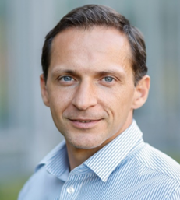
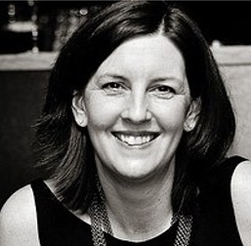
EURAD-2 RWM Infrastructures Task Team
Liz Harvey (GSL)
Task 3 Lead
Abishek Mishra (GSL)
Stella Foster (GSL)
Marcus Altmaier (KIT)
Naïm O'Neill (Amphos21)
Niels Belmans (SCK.CEN)
Alexandru Tatomir (BGE)
KM WP Lead
Erika Holt (VTT)
KM PMO Representative
2

Slide 5
Introduction to infrastructure activities within EURAD-2 (2024 - 2029)

Slide 6
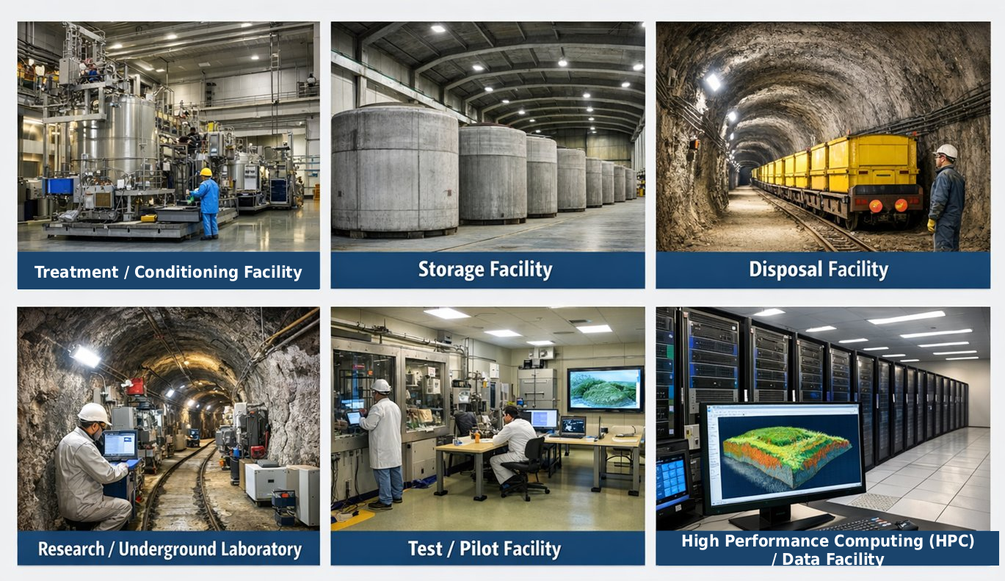
What do we mean by RWM Infrastructures?
2

Slide 7
Subtask 3.2 Infrastructures – objectives & Background
Background
Builds upon work in support of the EURAD Mobility Programme (supporting knowledge and skills exchange for RWM professionals, students and researchers)
EURAD-1 (2019-2024) output: list of research infrastructures (compiled in 2020 under EURAD-1 WP13)
Subtask 3.2 objectives & scope
To maintain an updated list of available infrastructures, identifying where there is potential for mobility actions
To use the updated list to facilitate an analysis of gaps in existing infrastructures, considering RWM infrastructure requirements across the EU and the extent to which these are expected to be met based on existing and currently planned facilities
2

Slide 8
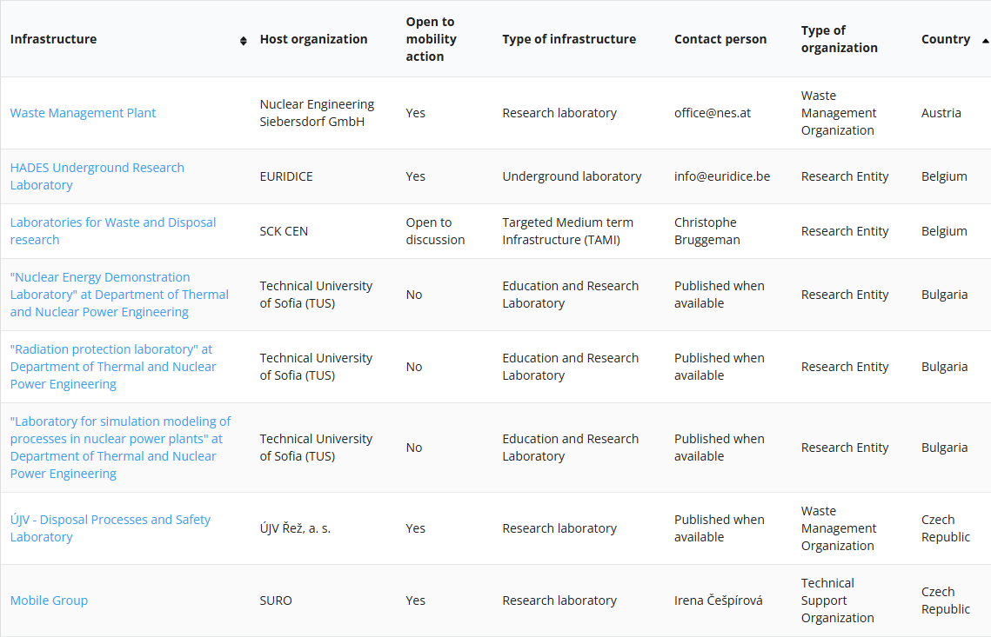
EURAD-2 RWM Infrastructure Catalogue: https://euradschool.eu/infrastructures/
Updated version published on the School of RWM website in January 2026
Improved coverage and accuracy
Information captured on potential support for mobility actions and collaborations
Scope of updates set out in Milestone 23 report published on EURAD-2 website
Further updates planned later in EURAD-2
2

Slide 9
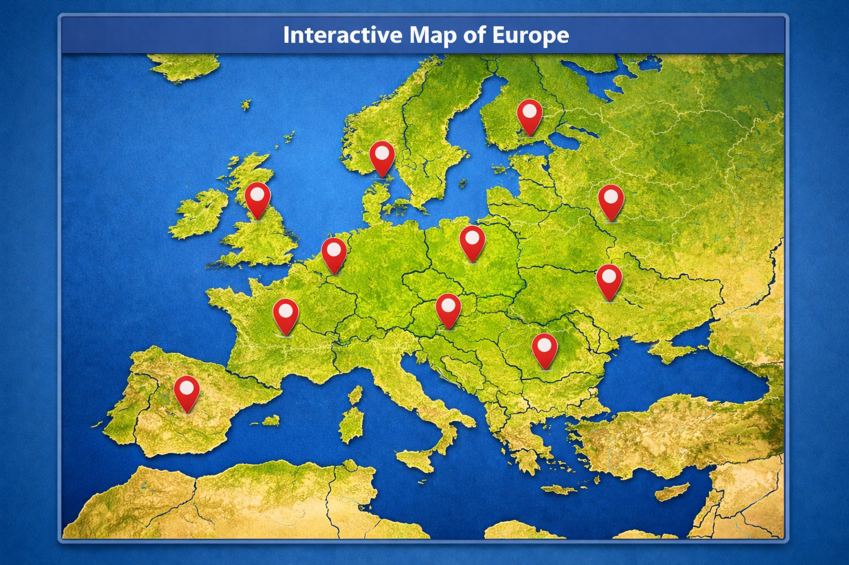
EURAD-2 Forward Programme on RWM Infrastructures
Infrastructure list is used to inform the Year 2 work programme, with work focusing on:
Exploring infrastructure capabilities against national programme needs
Identifying critical infrastructure needs, gaps, and long-term sustainability at the EU level
Will undergo further updates and functionality enhancements over the course of EURAD-2
Over the next six months, we will be focusing on examining infrastructure requirements to support national programme delivery and will consider how existing facilities align with identified needs, now and in the long term
To be set out in Deliverable D2.3, (Report on recommendations for the long-term maintenance of critical infrastructure for RWM at the European level), scheduled for completion in September 2026
Programme planning is also underway for infrastructure-related activities over Years 3-5 of EURAD-2, which will inform an update to the above deliverable
2

Slide 10
Thank you
Co-funded by the European Union under Grant Agreement n° 101166718

Slide 11
Infrastructure Initiatives (10:15 - 11:15)

Slide 12

Today's PresentERs
10:15 – 10:30 Bob Hoogendoorn, project leader for Geological Services for Europe (GSEU) (EuroGeoSurveys)
10:30 – 10:45 Jörg Rothe, Head of Radionuclide Speciation/Analytics Department (Karlsruhe Institute of Technology (KIT))
10:45 – 11:00 Máté Kukovecz, Policy-Coordinator (DG-ENER)
11:00 – 11:15 Stefaan Van Winckel, Research Scientist (Joint Research Centre (JRC))
2

Slide 13
Interactive Session (11:15 - 12:00)

Slide 14
Interactive Session - Introduction
As mentioned earlier, over the next six months, we will be focusing on examining infrastructure requirements to support national programme delivery and will consider how existing facilities align with identified needs, now and in the long term
This will inform preparation of Deliverable D2.3.
There are many different aspects of RWM infrastructure that could be explored – it’s a large and complex topic!
Three polls have been created to gather some early information to aid our planning and maximise the value of the analysis conducted
Further engagement, targeted at specific stakeholder groups is planned over the next few months
2

Slide 15
Polling Question 1
What types of RWM infrastructures are of particular interest to you?
Pre-treatment/Treatment Facilities
Conditioning Facilities
Storage Facilities
Disposal Facilities
Research Laboratories
Test/Pilot Facilities
Underground Laboratories
Educational/Training Facilities
High Performance Computing (HPC) Facilities (e.g. modelling or simulations)
Data Management Facilities
Other
2

Slide 16
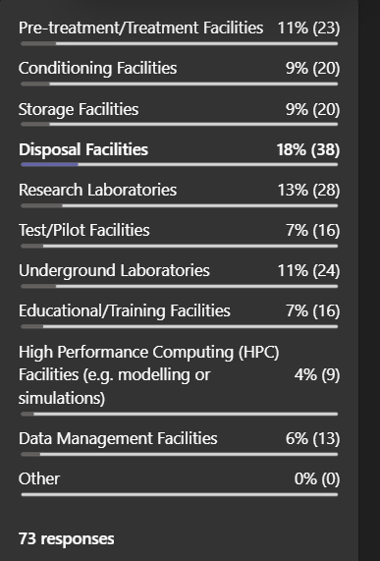
Polling Question 1 (Result)
What types of RWM infrastructures are of particular interest to you?
2

Slide 17
Polling Question 2
What gaps are you aware of in relation to RWM infrastructures?
2

Slide 18
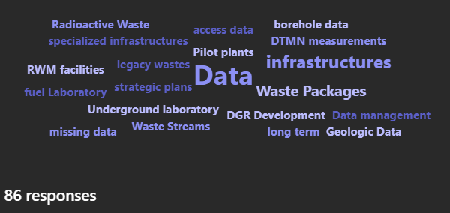
Polling Question 2 (Result)
What gaps are you aware of in relation to RWM infrastructures?
2

Slide 19
Polling Question 3
Which groups of stakeholders should we engage with to explore critical infrastructure needs?
2

Slide 20
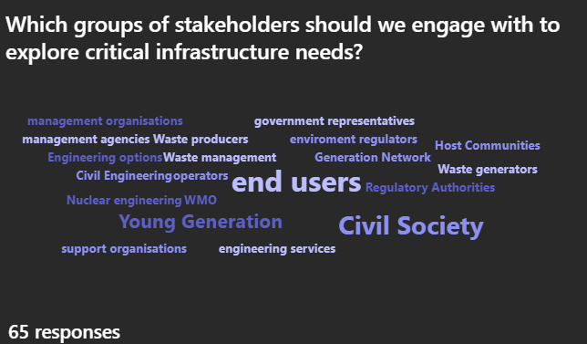
Polling Question 3 (Result)
Which groups of stakeholders should we engage with to explore critical infrastructure needs?
2

Slide 21
Summary and Conclusions
We will consider your inputs today in planning further engagement activities over the next six months, feeding into Deliverable D2.3 (Report on recommendations for the long-term maintenance of critical infrastructure for RWM at the European level)
Planning of the Year 3-5 programme of KM work on infrastructures is ongoing
Including update and enhancement of the EURAD-2 RWM infrastructures list
Please feel free to contact us to provide further feedback
2

Slide 22
Contact us for any questions, suggestions, proposals ....
Liz Harvey ejh@galson-sciences.co.uk
Abishek Mishra abm@galson-sciences.co.uk
Stella Foster sjf@galson-sciences.co.uk
On behalf of EURAD-2 RWM Infrastructures task team
Thank you for your attention
Co-funded by the European Union under Grant Agreement n° 101166718

